Slide 1
Critical Care Nutrition & Transplant
Shelby Yaceczko, MS, RDN, CNSC, CSSD

Slide 2
AGENDA
Who are you?
Defining your success
Who am I?
Defining a leader
Critical care nutrition

Slide 3
Who are you?
What brings you here today?
Who do you look up to?
What does success mean to you?
Money
Career
Family
Relationships
Travel / leisure
Retirement
Health

Slide 4
Resource Dietitian at USC Keck Hospital
Coverage for 15 RDs (inpatient / outpatient)
Services include:
All critical care units
Transplant (heart, lung, kidney, liver, pancreas)
Bariatrics

Slide 5
Orange District - CAND
National (Academy Nutrition Dietetics
State (California)
Local Districts (Orange)
More info:
https://www.dietitian.org/orange-county/

Slide 6
Board Exams as a RD
Also…..CNSC, CLEC, CDE

Slide 7
Defining a Leader
How do you define someone who is a leader?
Characteristics
Attitude
Typical day
Schedule
Interests

Slide 8
Growth in Clinical Nutrition
Management positions (outside nutrition)
Board of organizations
Publications
Tube placement
Scope of practice (ordering rights)
Licensure
Malnutrition
Requirements to have RDN

Slide 9
Hot Topics in Clinical Nutrition
Full versus partial nutrition support (initiation timing, bolus/continuous)
Malnutrition (MQII, outcomes, NFPE, $$)
Maintaining muscle mass (protein, supplements, steroids, appetite stimulants)
Measuring body composition (CT scans, ultrasound, BIA)
Special diets outside of “traditional” (Low FODMAP, SCD, Chyle leak, ketogenic)
“Real food” tube feedings and oral nutrition supplements
RD scope of practice

Slide 10
Critical Care Nutrition
GI function
Tube Access
Drips (pressor, fluids, sedation, lines)
Mentation
Procedure schedule
NPO time
Goals of care

Slide 11
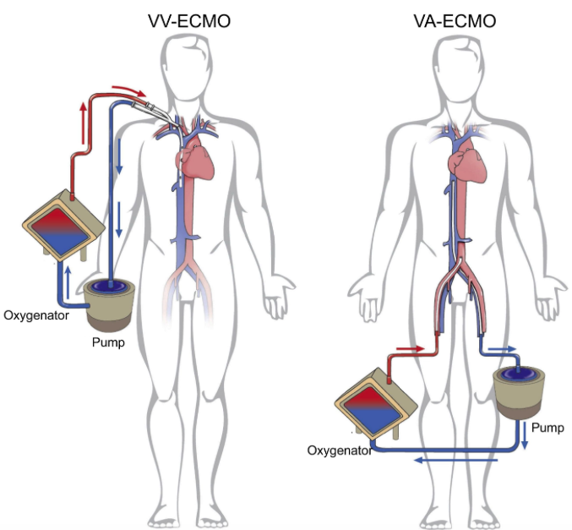
Extracorporeal membrane oxygenation (ECMO)
Pump circulating blood through artificial lung vs heart back into bloodstream
Advanced life support providing heart – lung bypass

Slide 12
Transplant Nutrition
Outpatient versus inpatient setting
Evaluation process (BMI, malnutrition, labs, compliance)
Selection committee (LCSW, RD, Surgery, MD)
Organs (individual versus joint)
Lifelong medications (immunosuppressants)
Food safety
Care plans (post assessment, education, discharge planning)

Slide 13
Be a Sponge
Absorb anything and everything
The things you think you know, you might not
Research and recommendations are constantly changing
Don’t get comfortable
Learn from your elders and the “newbies”
Network in the professional world (conferences, meetings, district chapters, state chapters)
You probably won’t agree with everything & everyone
Diversify yourself

Slide 14
Advice
Explore dietetics
Think outside dietetics
Conferences, workshops, educational enhancement
Leadership roles (district level, national level, student level)
Search for opportunities that aren’t available
Know your elders in addition to your peers
Confidence

Slide 15
Advice
Prepare for what you don’t know
Have a Plan B, a Plan C, and a Plan D
Say yes to opportunities
Be humble
Go with the flow – stay flexible
Find what success means to you

Slide 16
“Success isn’t just about what you accomplish in your life, it’s about what you inspire others to do.”

Slide 17
Questions?
Shelby.Yaceczko@gmail.com

