Slide 1
Student Dietetic Association
Welcome
Notes:
Things to do before Meeting:
-Print Member Sign in Sheets(6)
-Print Officer Sign in Sheet
-Print more membership forms (40)
-Bring CSULB Nutrition Stickers
-Make ballots for election
-Send Meeting reminder to SDA members and WOW sign in emails

Slide 2
Reasons to Become a Member
Gets you put on the exclusive e-mailing list.
Nutrition related job opportunities.
Volunteer opportunities on campus and in the community.
Great networking opportunities with peers and professionals in the field.
Monthly guest speakers from a variety of fields in nutrition and dietetics.
Easy and fun way to build your resumé.
Member of the Month, Semester, and Year.
Notes:
Speaker: David

Slide 3
Meet the Officers!
Faculty Advisor: Dr. Long Wang
President: David Rios
Vice President: Reah Chiong
Secretary: Amy James
Treasurer: Rebecca Tran
Historian Chair: Kaylee Brimm
Historian Co-Chair: Te’Ozja Hodge
Student Relations Chair: Steffanie Castaneda
Student Relations Co-Chair: Salina Veerasingham
Fundraising Chair: Stephanie Schnars
Notes:
Speaker: All Officers
Please state your name and position.

Slide 4
Meet the Officers!
Fundraising Co-Chair: Yunjie Marques
Community Outreach Chair: Austin Bou
Community Outreach Co-Chair: D’Anna Hester
Publicity/Webmaster: Elloisa Wong
Editor: Lauren Kaida
AND Student Liaison: Kelly Herbst
Symposium Chair: Open
Symposium Co-Chair: Open
Student Male Liaison: Open

Slide 5
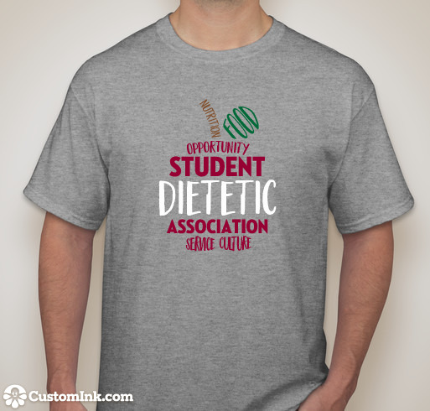
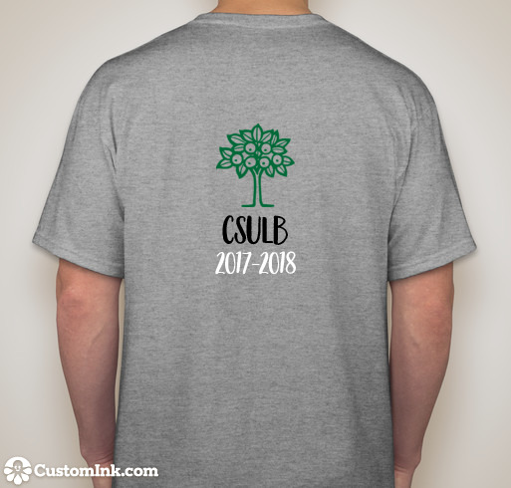
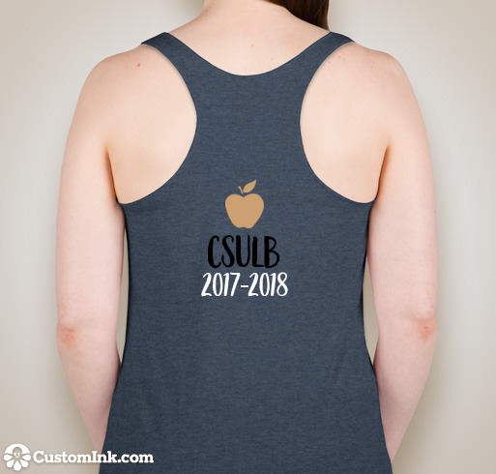
T-Shirts & Tanks
T-shirts $18
$30 with a semester membership
$38 with a year membership
Tank Top $15
Membership Fees:
$20 for the year.
$12 for the semester.
Notes:
Speaker: David or Reah

Slide 6
Member of the Month
Points awarded based on member participation
You can win Member of the Month, Semester or Year!
Month/Semester: earn a certificate & a prize.
Year: earn a certificate & an awesome prize!
Certificate (great for your resume!)
Ways to earn points:
Wear SDA t-shirt to meetings
Attend a volunteer event (on or off campus)
Donation to Guilt Free Snack Shack (or just stop by!)
Attend an CAND meeting
Attend a fundraising event
Tag us on Instagram or Facebook
Notes:
Speaker: David

Slide 7
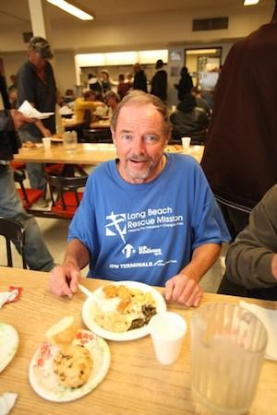
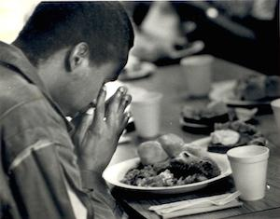
Volunteer Opportunities
Long Beach Rescue Mission
When: Saturday, September 30
Time: 5:30 - 7:30PM
Notes:
Speakers: Austin & D’Anna

Slide 8
Volunteer Opportunities
JetBlue Long Beach Marathon
When: Sunday, October 8 Time: 7AM~1PM Where: On campus!
Theme: ❀Hawaiian❀

Slide 9
Guilt Free Snack Shack
What: A Monthly table that sells healthy snacks to people on campus
When: Tuesday, October 3rd 11:00-1:30PM
Where: In front of the Psychology Building
Donate to Guilt Free Snack Shack!
Perfect Way to Earn Member of the Month Points!
Items to Donate:
Healthy Pre-packaged foods and/or water bottles
Examples: Granola bars, Trail Mix, Nuts, Popcorn, etc.
Notes:
Speakers: Kaylee & Tee
Note: Items must be pre-packaged
How many points do they get if they donate? Per Item donated?

Slide 10
Fundraising Events
Lyft Promo Code
CSULBSDA17-18
Halloween Face Painting Event
October: TBD
More information about the event will be sent out via email
Notes:
Speakers: Stephanie and Yunjie

Slide 11
Join the Academy of Nutrition & Dietetics
Networking and knowledge sharing opportunities with professionals, interns, and fellow students in the field
Opportunity to attend conferences and meetings where you can hear from great speakers (student discounts)
Scholarships
Free Food and Nutrition magazine subscription
Access to journals, libraries, and more
Gain a sense of community and belonging within the field
Annual dues for student: $58 (June 1st-May 31st)
http://www.eatrightpro.org/ (Click Join/Renew in upper right corner)
Notes:
Speaker: Kelly

Slide 12
CAND-Orange District Event Upcoming Events
Annual dues for student: $10.50 (June 1st-May 31st)
http://orangedistrict.dietitian.org/
CAND-OD Legislative Mixer
Friday, October 27th
Il Fornaio Italian Restaurant in Irvine
6:00pm-9:00pm
November Meeting- LA District and Orange District Mixer
Saturday, November 18th
Long Beach City College
8:30am-12:30pm
Notes:
Speaker: Kelly

Slide 13
SDA Website
Follow us on:
Twitter: @csulbsda
Instagram: @csulb_sda
Facebook.com/csulbsda
Email address:
csulbsda@gmail.com
Notes:
Speaker: Elloisa

Slide 14
Welcome Emily Phillips, RD
CAND-OD Speaker Bureau Representative

Slide 15
Elections
Only SDA Members can vote.
Each candidate will give a 1-2 minute speech on why you would be a good fit as an officer.
Notes:
Speaker: David

Slide 16
Next Member Meeting
October 19th
5-6pm
Room: TBA
Notes:
Speaker: David

